Slide 1
Big Data & Hadoop
Prepared by: Mohammed Sayeeduddin

Slide 2
What is Big data
Big data refers to vast amounts of structured and unstructured data that cannot be effectively processed using traditional database management tools. This data is characterized by its volume, velocity, and variety. One prominent use case is in retail, where big data analytics can analyze customer purchase patterns to personalize marketing campaigns, optimize inventory management, and improve overall customer experience.

Slide 3
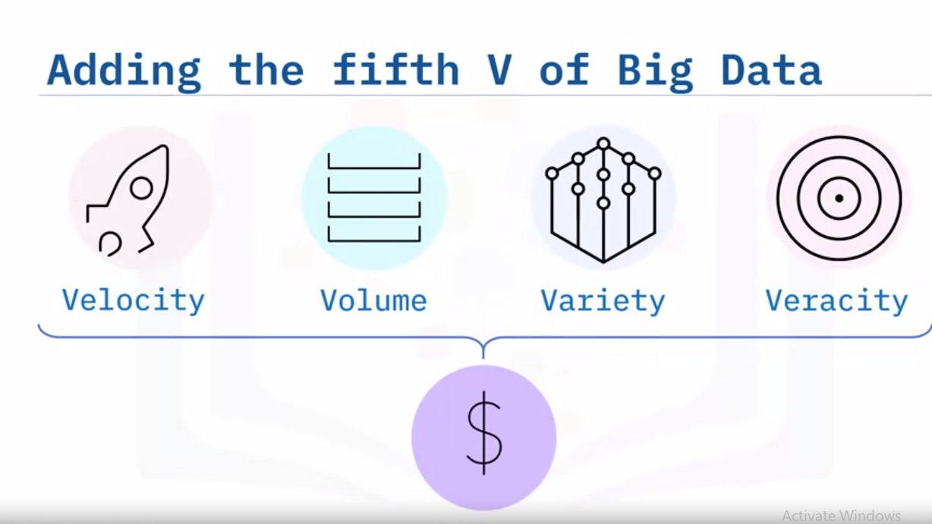
4 Values add 5th V

Slide 4
Vs in details
The four V's of big data are Volume, Velocity, Variety, and Veracity.
1. Volume: Refers to the sheer amount of data generated and collected. For example, social media platforms like Facebook accumulate enormous volumes of user-generated content daily.
2. Velocity: Represents the speed at which data is generated and processed. An example is high-frequency trading in finance, where massive amounts of data are analyzed in real-time to make split-second trading decisions.

Slide 5
3. Variety: Describes the diverse types of data, including structured, semi-structured, and unstructured data. An example is healthcare, where patient data includes medical records, lab results, imaging scans, and even patient-generated data from wearable devices.
4. Veracity: Reflects the reliability and accuracy of the data. In fraud detection, for instance, financial institutions analyze various data sources to determine the veracity of transactions and identify potential fraudulent activities.
These V's highlight the challenges and opportunities associated with big data across various industries.

Slide 6
5th V
The 5th V is Value

Slide 7
Big Data & Hadoop
If big data is the requirement, then Hadoop is one of the prominent solutions.

Slide 8
Brief History
Hadoop faced lot of challenges due to traditional processing concept
Data locality & Process locality
Hadoop faced challenges and wasn't widely adopted until after Google's publications on MapReduce and Bigtable. Google's papers provided valuable insights into large-scale data processing and storage, which helped validate the concepts underlying Hadoop. These publications acted as a catalyst for Hadoop's popularity by providing a roadmap for building scalable, distributed systems for big data processing. Hadoop then gained momentum as organizations recognized its potential for handling large-scale data processing tasks effectively.

Slide 9
Google File System
https://static.googleusercontent.com/media/research.google.com/en//archive/gfs-sosp2003.pdf

Slide 10
What is data locality and Process locality
Data locality: Process goes to the data.
Process locality: Data comes to the process.

Slide 11
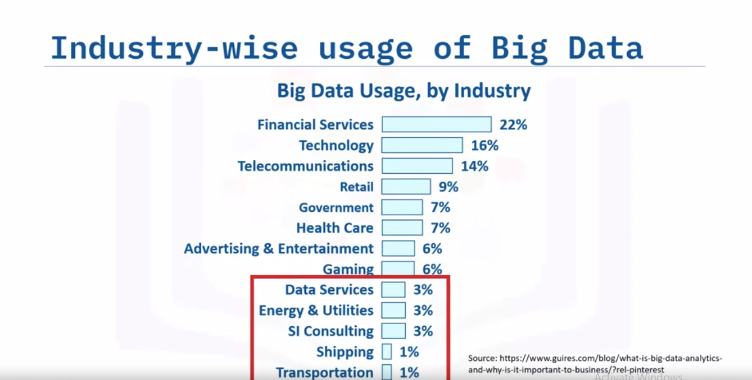

Slide 12
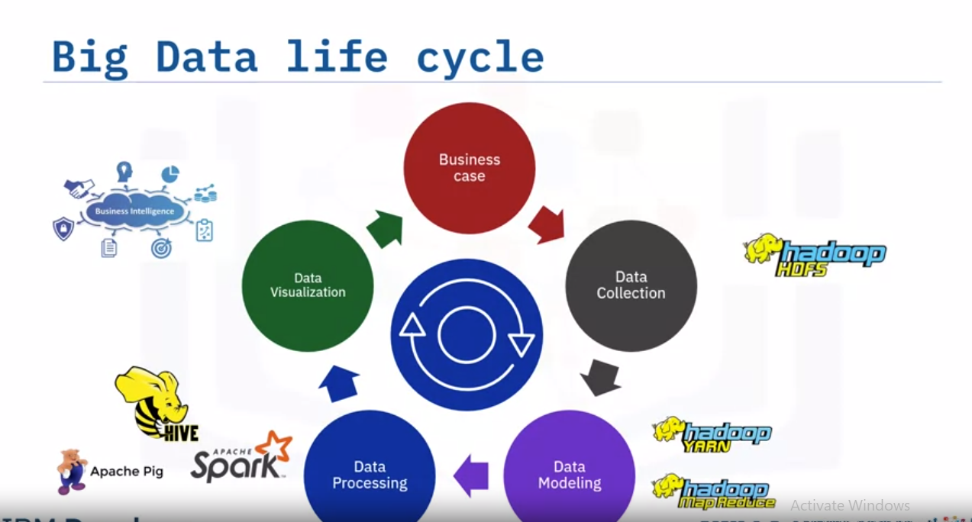
Life Cycle of Big data

Slide 13
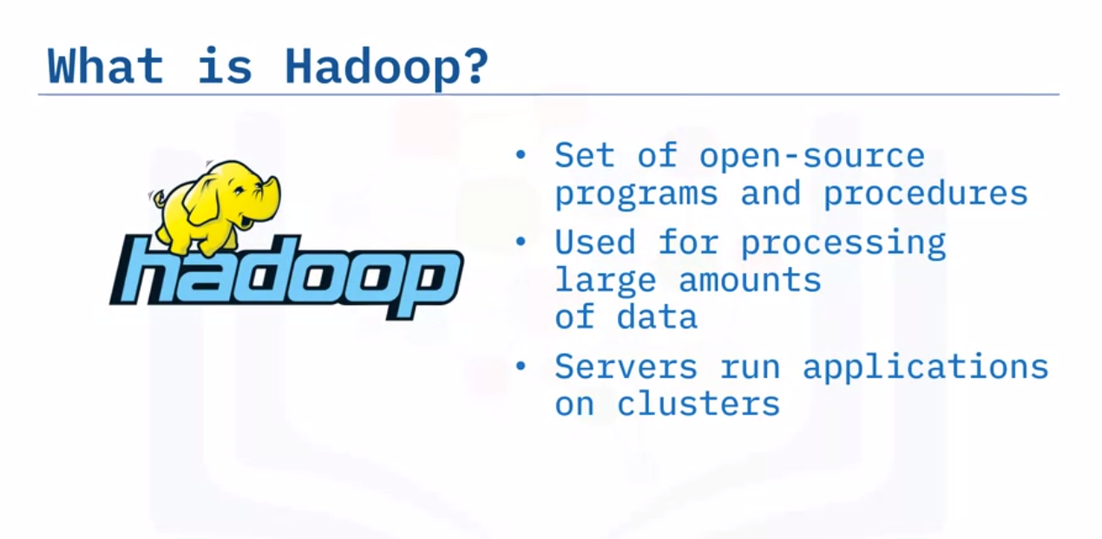

Slide 14
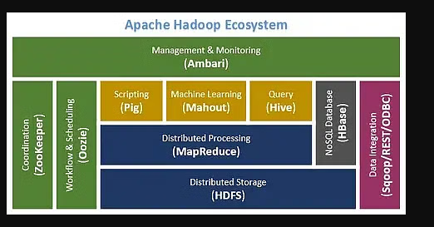

Slide 15
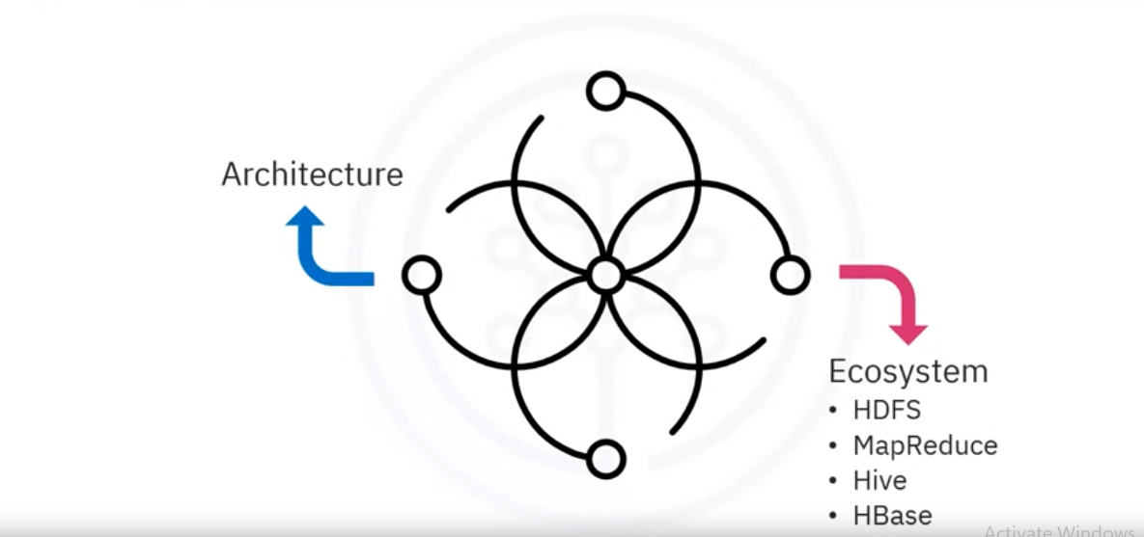

Slide 16
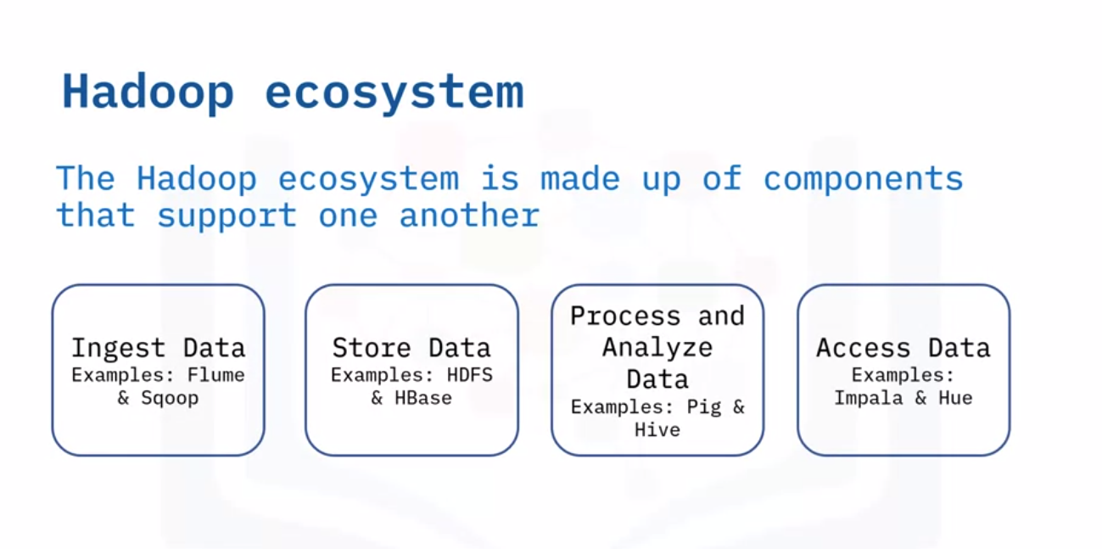

Slide 17
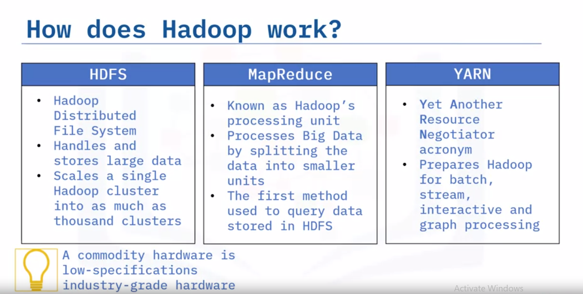

Slide 18
Whats HDFS
HDFS, or Hadoop Distributed File System, is the primary storage system used by Hadoop. It is designed to store large datasets across distributed clusters of commodity hardware. HDFS provides high-throughput access to data and is fault-tolerant, ensuring data reliability even in the face of hardware failures. Key features include data replication for fault tolerance, block-based storage, and a master-slave architecture consisting of NameNode and DataNodes. HDFS is optimized for handling big data workloads and serves as the foundation for many distributed computing applications within the Hadoop ecosystem.

Slide 19
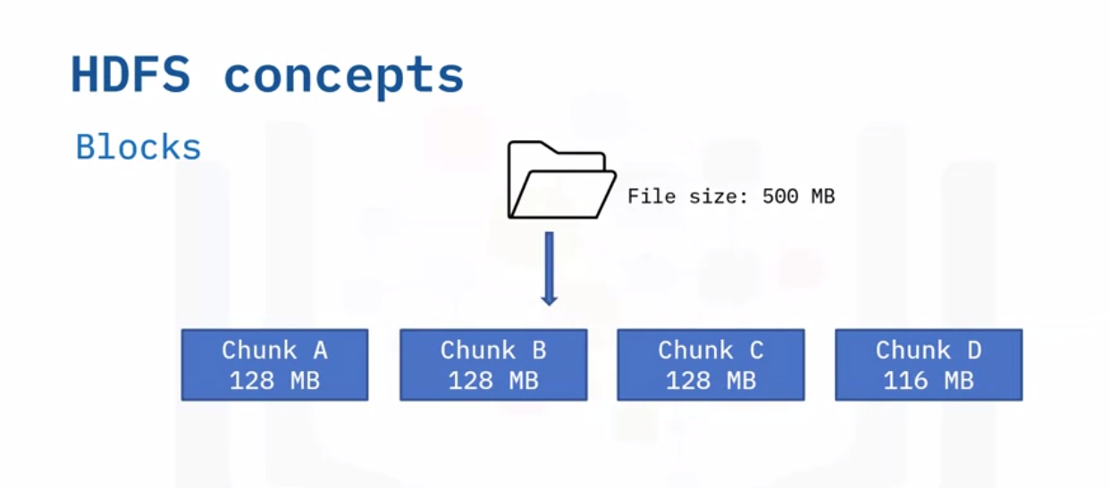

Slide 20
HDFS Command
Login to cloudera for activities

